Slide 1
Shakespeare's Places
Poi – Avveduto, Cecire, Cinquetti

Slide 2
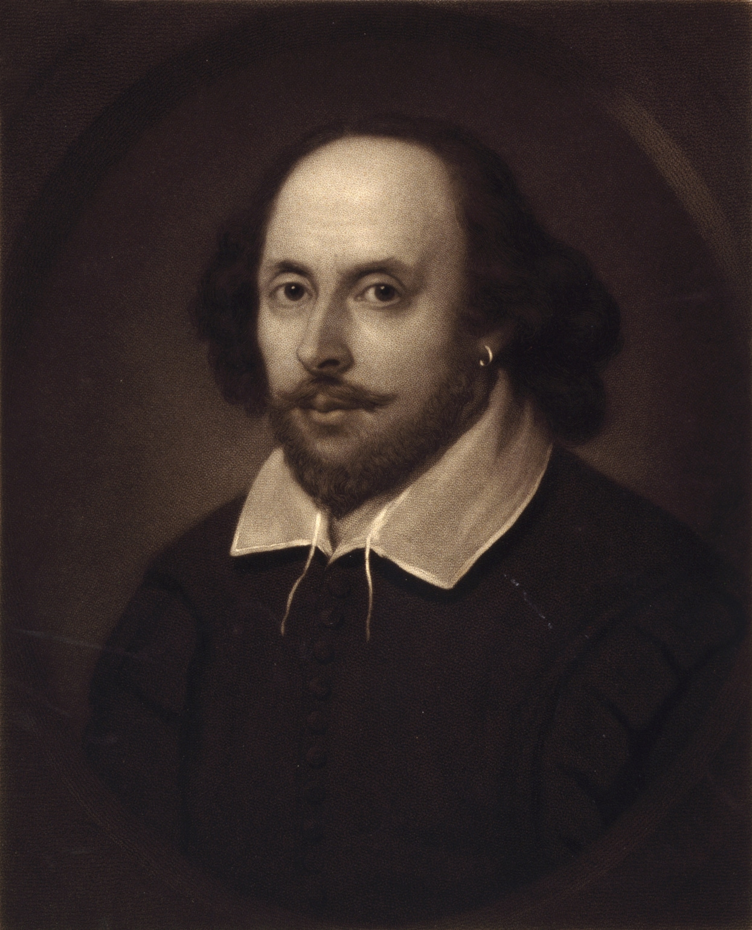
The project
Single page web application
Ten famous Shakespeare’s plays and their real-world locations
Component-Based Architecture

Slide 3
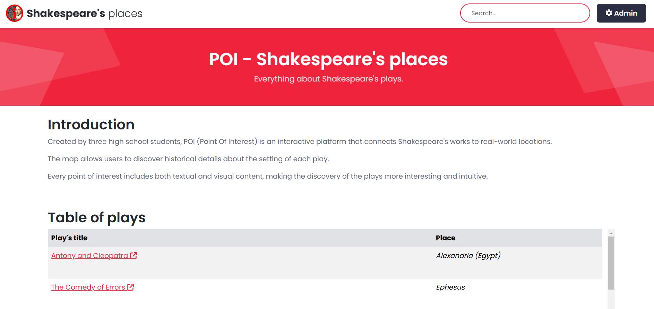
Navigation and organization of the app
Home page
One administration section
Different pages for all the plays
Search bar
Table and map of

Slide 4
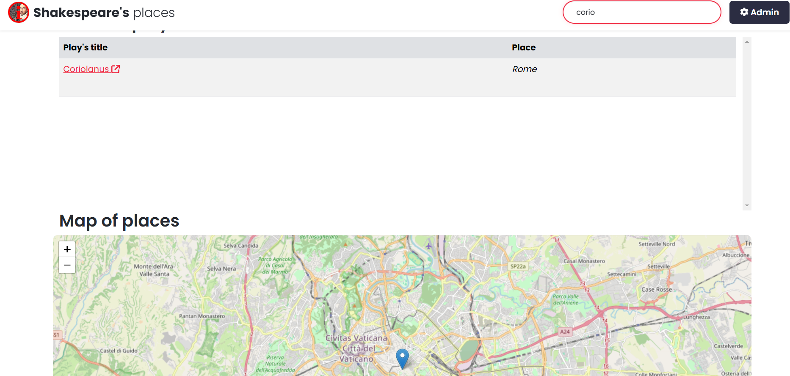
Searching articles
Search by play’s title
Search by place name

Slide 5
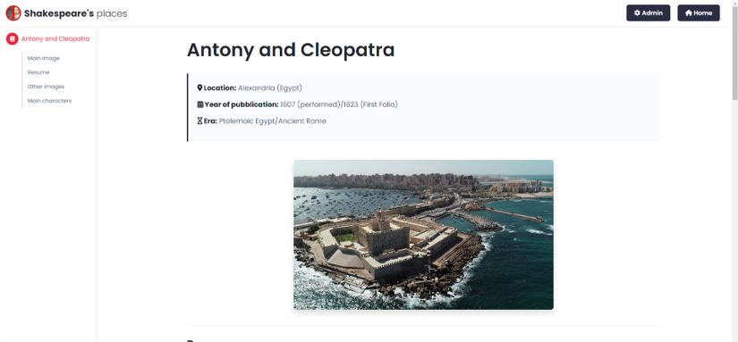
Play’s article
Location
Year of publication
Era
Images
Resume
Main characters
Despite the being an SPA every play has his own URL

Slide 6
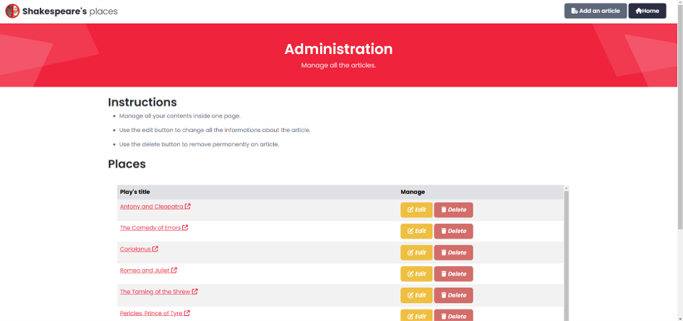
Administration section
Private section (has a login page)
Allows the creation, update and removal of articles

Slide 7
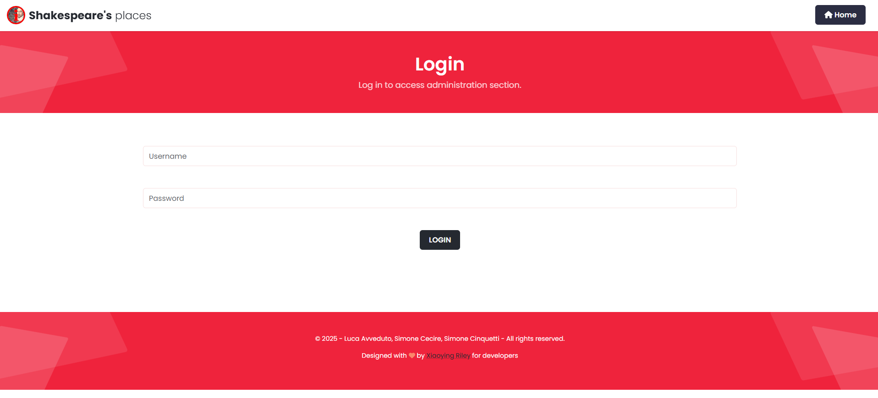
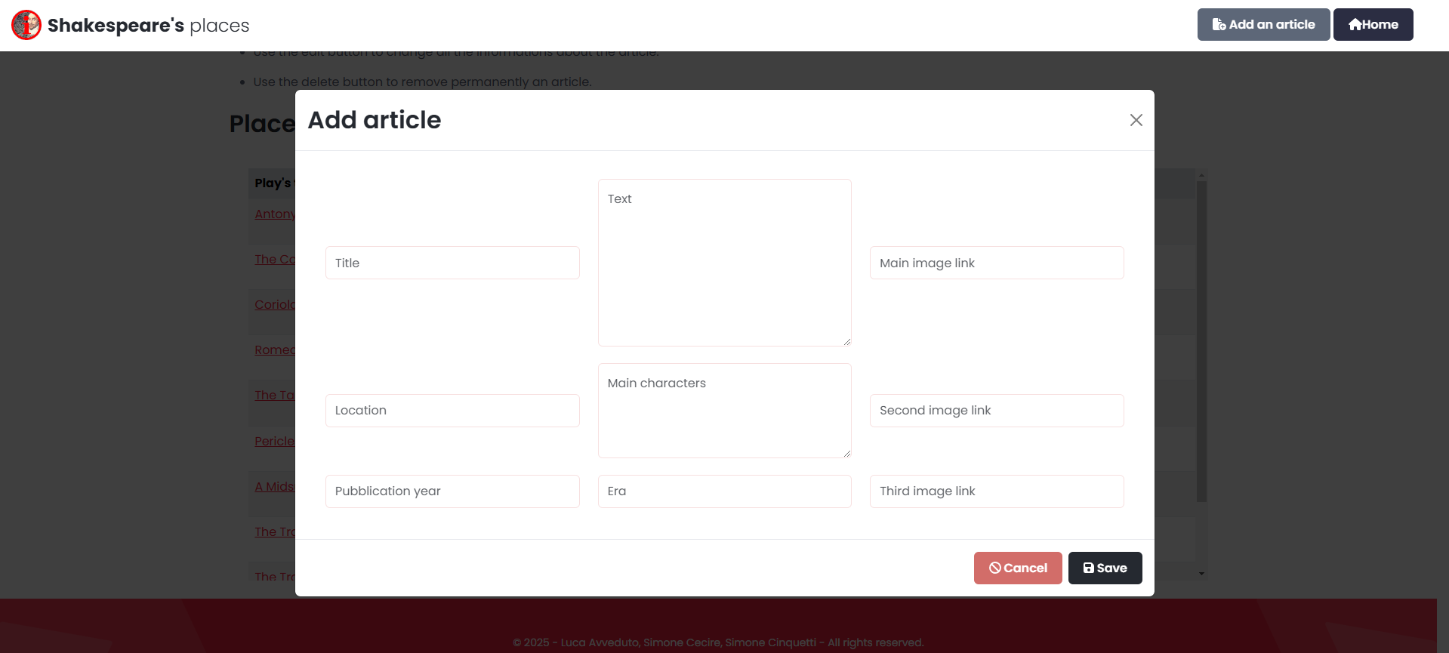
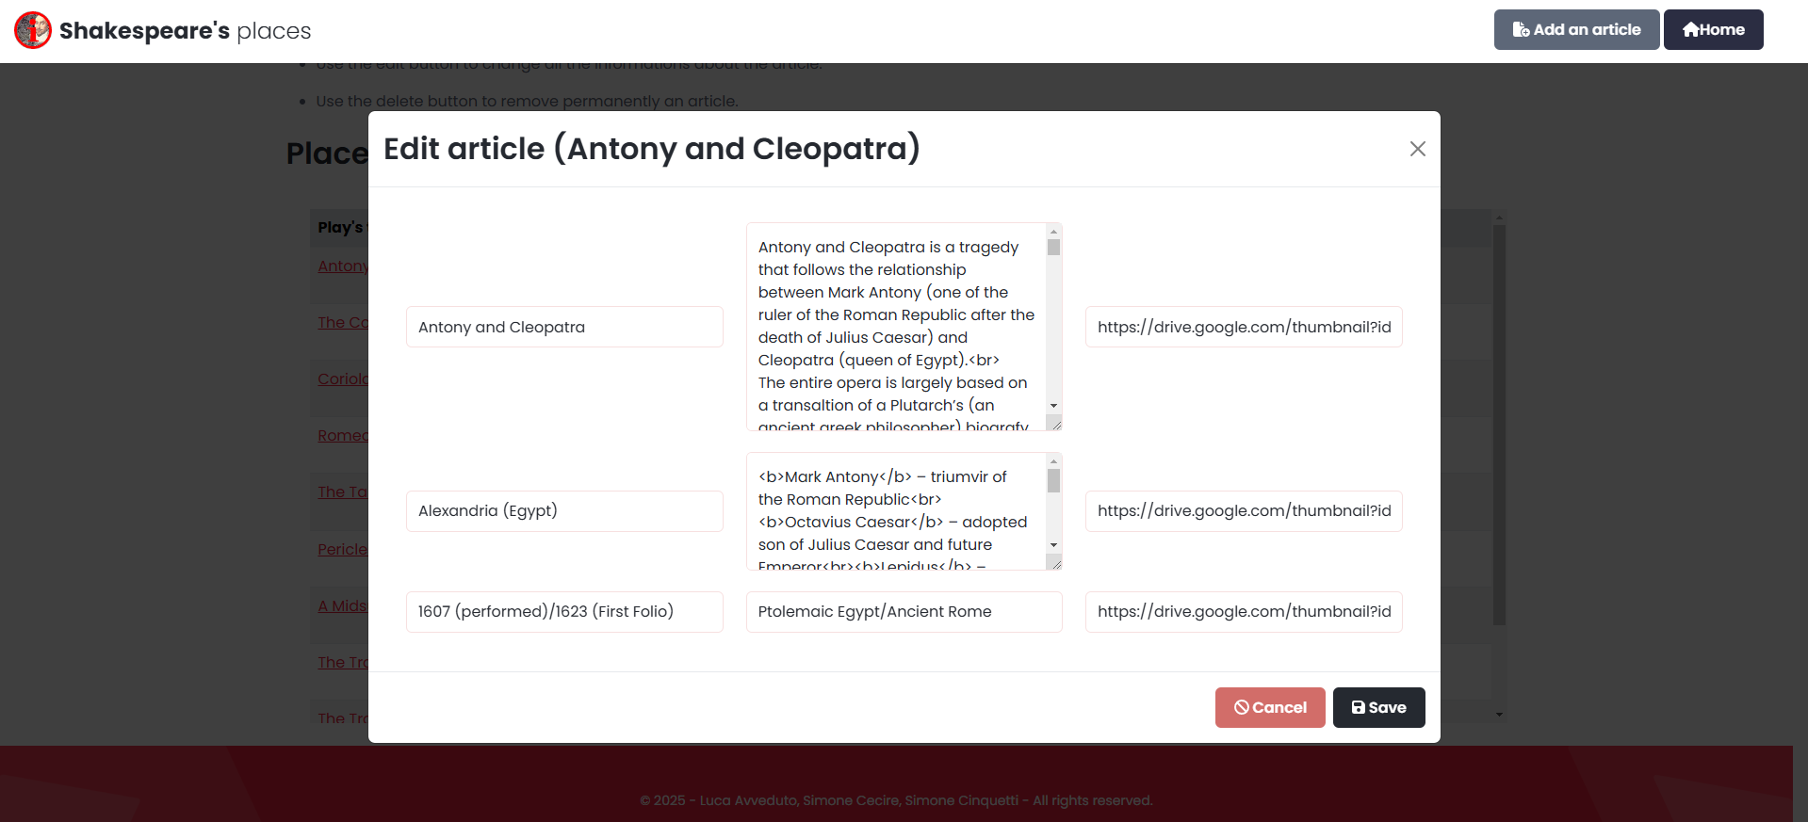
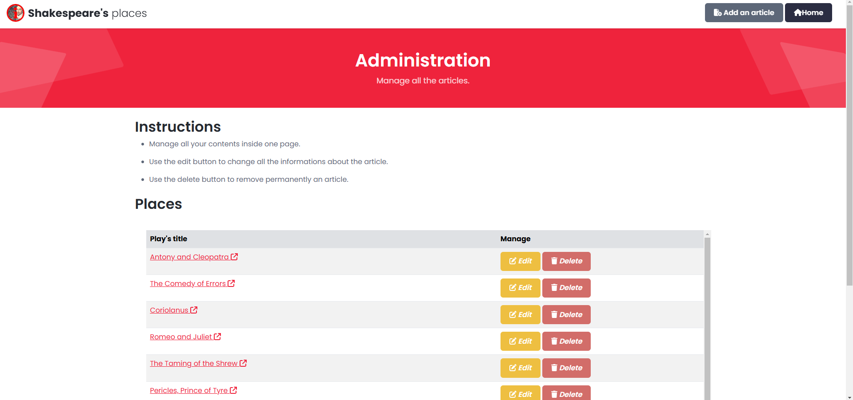
ADD
EDIT

